Slide 1
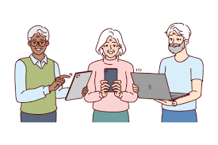
INTRODUCTION TO DIGITAL LITERACY

Slide 2
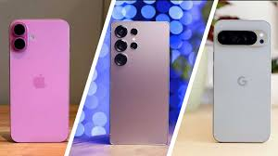
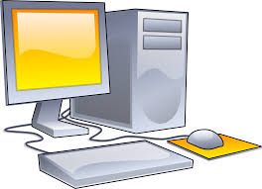
What is Digital Literacy?
LET US UNDERSTAND WITH A FEW EXAMPLES.

Slide 3
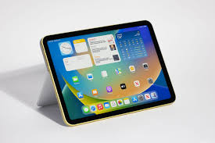
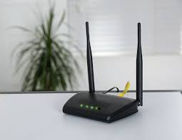

Slide 4

Digital literacy means knowing how to use technology like smartphones, computers, and the internet safely and effectively.
Why is it Important?
It allows them to use assistive tools like screen readers, speech-to-text apps, and smart home devices. These technologies make communication, education, and work more accessible.
Enhanced Access to Information and Services
Increased Employment Opportunities
Supporting Personal Growth and Creativity
Improved Health and Well-being Management

Slide 5




COMMON VOCABULARY
App – A software application that you can download and use on your phone, tablet, or computer (like Instagram, WhatsApp, etc.).
Cloud – A place where you can store your files, photos, and documents online so you can access them from any device (like Google Drive or iCloud).
Email – A way to send and receive messages electronically over the internet.

Slide 6

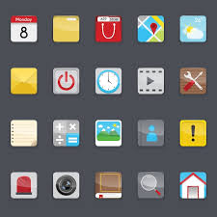
Virus – Malicious software that can damage your computer or steal your personal information.
Icon: An icon is a small image displayed on the screen to represent an object.
Menu: A menu is a list of options from which a user can select an option to perform a desired action, such as choosing a command or applying a particular format to part of a document.

Slide 7
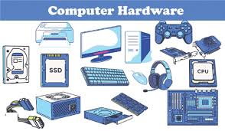
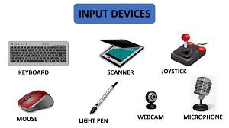
Online: When a computer is connected to the Internet, it is said to be online.
Hardware: Hardware refers to all the physical components of a computer.
Input Device: An input device is used to provide
information to a computer. A keyboard is an example of an input
device.
Platform: The hardware and the operating system together are referred to as a platform.

Slide 8
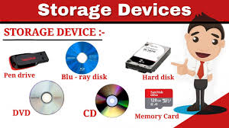
Storage Devices: Storage devices are used to store data. A hard disk is an example of a storage device.
The Web : The Web, also known as the World Wide Web (WWW), is a collection of information that is accessible on the Internet. This information is arranged logically and stored on computers known as Web servers.
Password: A secret code or combination of letters and numbers you use to keep your online accounts secure.

Slide 9



Upload – The process of transferring a file from your device to the internet (like uploading a photo to Facebook).
Link: A clickable text or image that takes you to another webpage when you click on it.
Search: Looking for something on the internet using a search engine like Google.

Slide 10
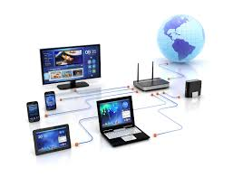
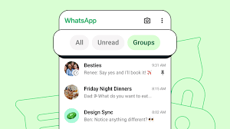
Chat: A way to communicate with people online, often in real-time, like sending messages through WhatsApp or Facebook Messenger.
Network: A network is a group of computers that are connected to share resources and exchange information
Local Area Networks: A LAN connects devices within a limited area, such as a home or a small group of offices.

Slide 11

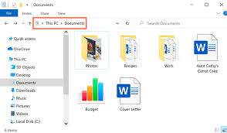
File – A collection of data, like a document, photo, or video, stored on your computer or online.
Internet Service Provider: An ISP is a company that provides Internet connectivity to individuals, businesses, and organizations. (Example: Airtel, Jio etc.)
Download – The process of transferring a file from the internet to your device (like downloading a song or app).

